Slide 1
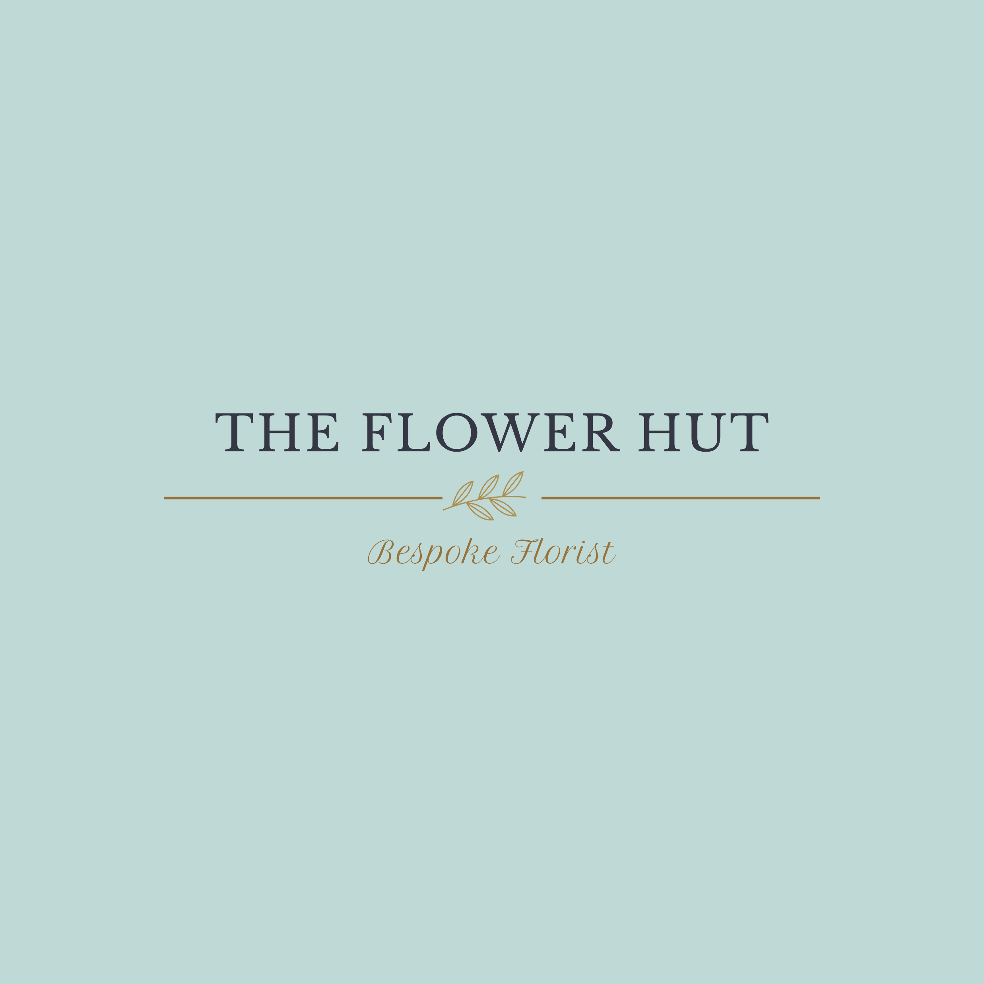
Wedding
Terms & Conditions
Payment
When you book a wedding with The Flower Hut Florist I take a 40% deposit. This saves the date and if for any reason you cancel your wedding this deposit is non refundable. The deposit will be deducted from the final balance which is due, in full, 28 days before the wedding. Payment of a deposit is acknowledgement of the Terms & Conditions.
Clients are encouraged to contact me with any questions or details regarding their wedding day, and any amendments can be made up to 30 days before the wedding day itself (2 days prior to when the final payment is due). I cannot guarantee any amendments made after this will be fulfilled.
Cancellations
I have the right to terminate a contract if a dispute cannot be resolved. If we have to take the decision to cancel due to slander, abusive conduct etc, all moneys paid are forfeit and there is no right to any refund.
There are no refunds for cancellations of individual items after the final balance has been paid, unless by the agreement of both parties.
In the unfortunate event of cancellation, the booking fee cannot be refunded. Complete cancellation of the wedding must be advised in writing. Cancellations made less than two weeks before the wedding date may forfeit full payment if The Flower Hut Florist has ordered flowers and the order cannot be cancelled.
In the unlikely event that I have to cancel for unavoidable circumstances, for example in the event of fire, natural disaster, death, serious family illness or tragedy all money paid by the client will be repaid. The Flower Hut Florist are only responsible for refunding moneys paid, and not anything to do with any other costs incurred by the inconvenience. All reasonable efforts will be made by The Flower Hut Florist to find a replacement florist option which would be paid for by the client.
Cancellations made less than two weeks before the wedding date may forfeit full payment if The Flower Hut Florist has ordered flowers and the order cannot be cancelled.
Covid 19/pandemic government enforced lockdown
In the event that the wedding is cancelled due to a national lockdown, any deposit/moneys paid (this excludes the wholesale bill once flowers are ordered) can be carried forward to another date. Prices and availability may however change due to the changes of seasons and inflation. In the event of a national lockdown, The Flower Hut Florist cannot refund any payments after the flowers and foliage have been ordered for the clients’ wedding.
Availability of Flowers
The Flower Hut Florist cannot guarantee specific stem types but will always endeavour to work with your wish list, colours and theme and if available will include your specified flowers/foliage. However, if they are unavailable or the quality is inadequate in accordance to my professional opinion, I will use suitable alternatives which match closest to your requirements. The Flower Hut prides itself on using fresh, quality flowers and a lot of love, time, skill and attention will always go into giving my clients beautiful flowers.
Wedding flowers are designed to look their best for the day of the event. I cannot guarantee that flowers will last significantly past the event. Roses and some other flowers can bruise if knocked or dropped. The Flower Hut Florist cannot take any responsibility for damage caused to flowers after delivering to or on behalf of the client. Some flowers may be susceptible to wilting on a warm day if out of water. The Flower Hut Florist cannot take responsibility for the conditioning and care of the flowers after delivering to or on behalf of the client.
Photographs
The Flower Hut Florist reserves the right to take photographs of all work both in the flower hut and on setting and may use them for promotional purposes such as the website and social media. Any photos you share with me I may also use for my portfolio to show prospective clients examples of my work unless specifically instructed not to do so. Any personal details from the customer will never be shared. Any concerns should be shared with me directly.
Please note:
That some flowers and foliage are poisonous to digest.
Some roses may have thorns on the stems, however I will always do my best to remove them beforehand.
You may be asked if you would prefer magnets instead of pins to attach corsages onto clothes. Please ensure that guests wearing these do not have a pacemaker fitted. A magnet may stop the pacemaker from working properly and The Flower Hut Florist accepts no responsibility for any resulting health issue which may arise from magnets and pacemakers or ICDs.
The Flower Hut Florist does not accept responsibility for any injuries caused to any person/s relating to The Flower Hut Florist’s equipment, props, hired items or arrangements.
No responsibility is accepted by The Flower Hut Florist for any damage/harm caused by candles used in candelabra/hurricane lamps/candle holders either burns or damage from hot wax or flame.
Complaints Any complaints must be made within 24 hours of delivery along with photographic evidence. No responsibility can be taken with regards to poor condition once flowers have been approved. Hired items Any items borrowed/hired from The Flower Hut Florist will remain the property of The Flower Hut Florist. It is the client’s responsibility if any items are missing, damaged or broken.

Slide 2
General
Terms & Conditions
Cancellations
I have the right to terminate a contract if a dispute cannot be resolved. If we have to take the decision to cancel due to slander, abusive conduct etc, all moneys paid are forfeit and there is no right to any refund.
There are no refunds for cancellations of individual items after the final balance has been paid, unless by the agreement of both parties.
Availability of Flowers
The Flower Hut Florist cannot guarantee specific stem types but will always endeavour to work with your wish list, colours and theme and if available will include your specified flowers/foliage. However, if they are unavailable or the quality is inadequate in accordance to my professional opinion, I will use suitable alternatives which match closest to your requirements. The Flower Hut prides itself on using fresh, quality flowers and a lot of love, time, skill and attention will always go into giving my clients beautiful flowers.
Hired items
Any items borrowed/hired from The Flower Hut Florist will remain the property of The Flower Hut Florist. It is the client’s responsibility if any items are missing, damaged or broken.
Payment
Payment of a deposit or in full is acknowledgement of the Terms & Conditions.
Full payment will be required when purchasing flowers from The Flower Hut Florist. Failure to do so will mean the client won’t receive the flowers.
Delivery
The Flower Hut Florist will always deliver your flowers unless there is a prior agreement for you to collect. Delivery charges apply.
Full delivery details must be supplied.
Complaints
Any complaints must be made within 24 hours of delivery along with photographic evidence. No responsibility can be taken with regards to poor condition once flowers have been approved.
Please note:
That some flowers and foliage are poisonous to digest.
Some roses may have thorns on the stems, however I will always do my best to remove them beforehand.
The Flower Hut Florist has the right to terminate an order if a dispute cannot be resolved. If we have to take the decision to cancel due to slander, abusive conduct etc, all moneys paid are forfeit and there is no right to any refund.
The Flower Hut Florist does not accept responsibility for any injuries caused to any person/s relating to The Flower Hut Florist’s equipment, props, hired items or arrangements.
No responsibility is accepted by The Flower Hut Florist for any damage/harm caused by candles used in candelabra/hurricane lamps/candle holders either burns or damage from hot wax or flame.
Funeral Flowers:
The Flower Hut Florist promises to always take time and care creating a goodbye tribute for somebody’s loved one and will always hope that the flowers turn out just right for day. We cannot however accept any responsibility for any damage potentially caused after delivery of the flowers, whether that is to the undertakers or to the client.
The Flower Hut Florist cannot guarantee specific stem types but will always endeavour to work with your wish list and colours and if available will include your specified flowers/foliage. However, if they are unavailable or the quality is inadequate in accordance to my professional opinion, I will use suitable alternatives which match closest to your requirements. The Flower Hut prides itself on using fresh, quality flowers and a lot of love, time, skill and attention will always go into giving my clients beautiful flowers.
Funeral flowers are designed to look their best for the day of the event. I cannot guarantee that flowers will last significantly past the event. Roses and some other flowers can bruise if knocked or dropped and chrysanthemums can shatter. Some flowers may be susceptible to wilting on a warm day if out of water. The Flower Hut Florist cannot take responsibility for the conditioning and care of the flowers after delivering to or on behalf of the client.

